Slide 1
Kantinedilemma resultater
Plots
2. Perspektiv fra andet forsknin
3. Problemer og forbedringer

Slide 2
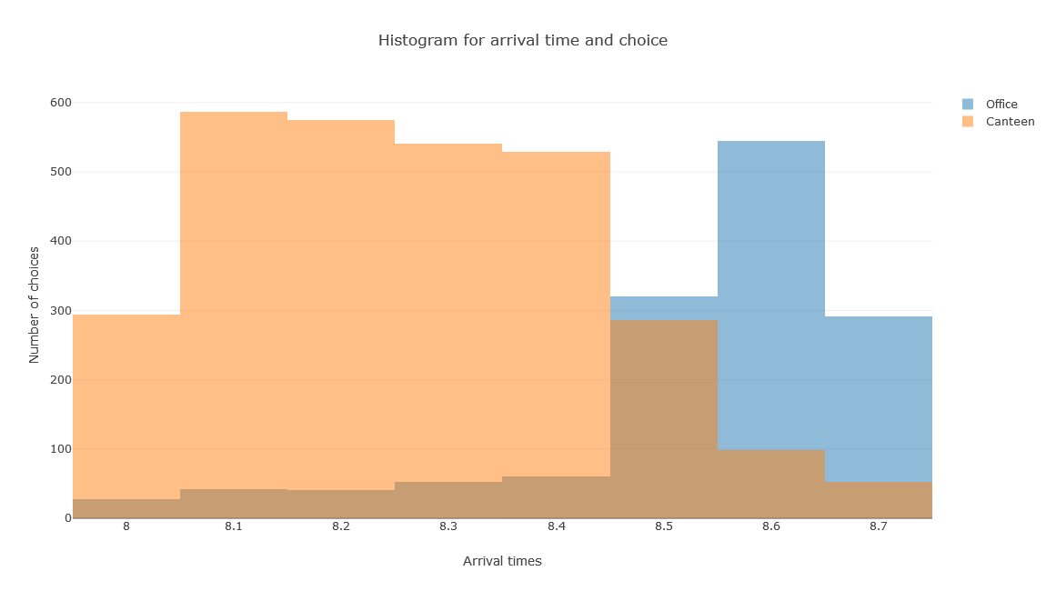
Plot 1
https://plot.ly/create/?fid=thomasnicolet%3A273&fbclid=IwAR3AnJg9pwYzCpHR1fFxIa375CEWWZqHxfV2TnabGHywg2dGfgBR-Oedt30#/

Slide 3
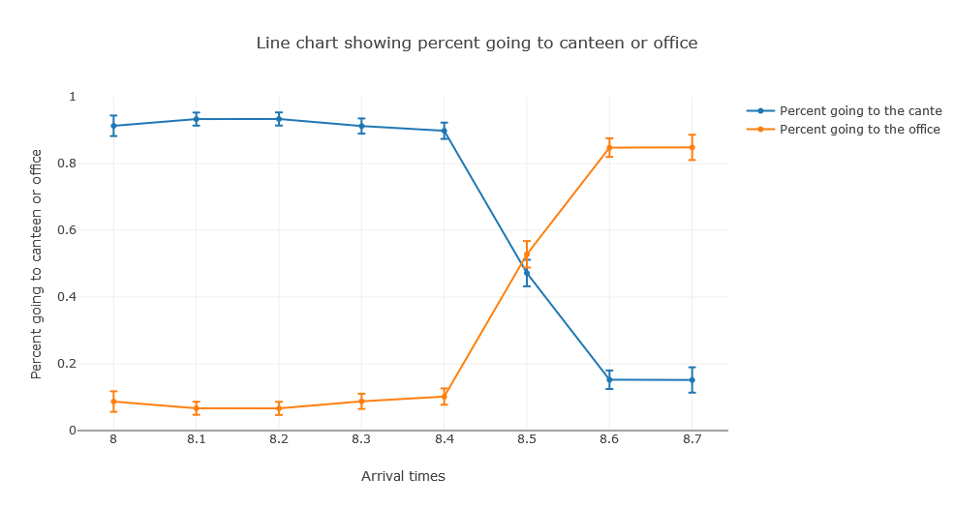
Plot 2

Slide 4
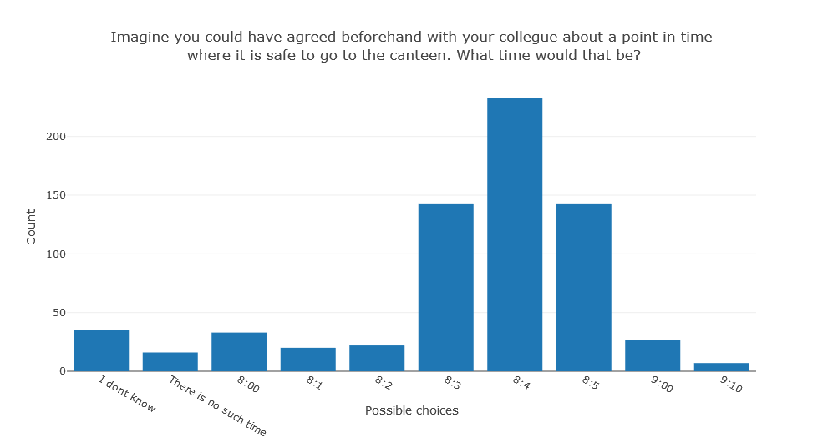
Plot 3

Slide 5
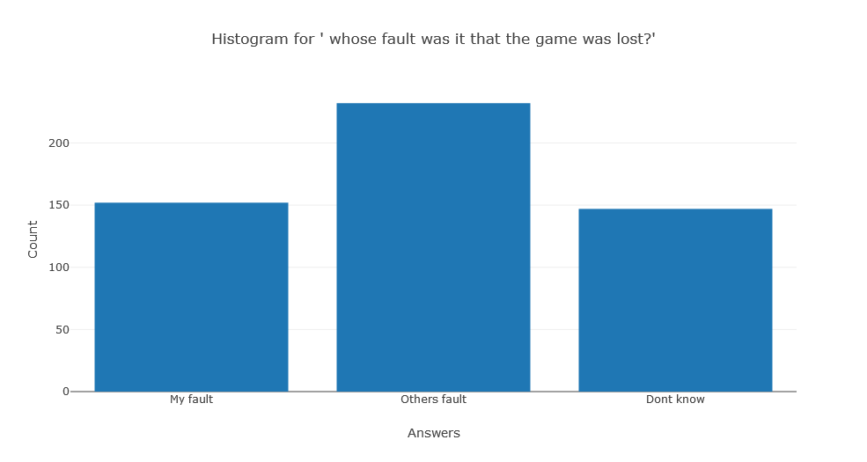
Plot 4

Slide 6
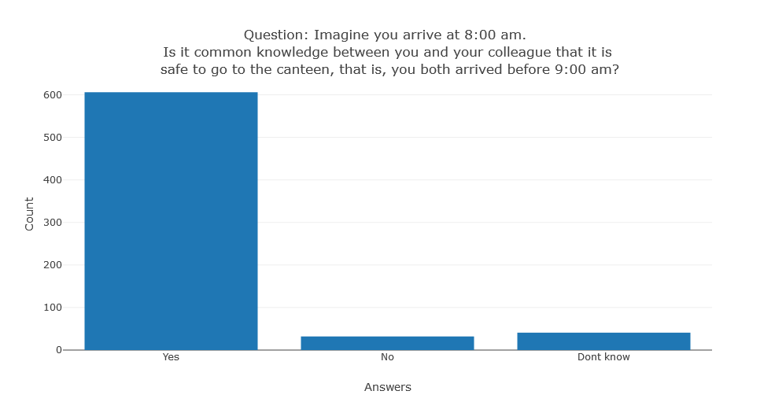
Plot 5

Slide 7
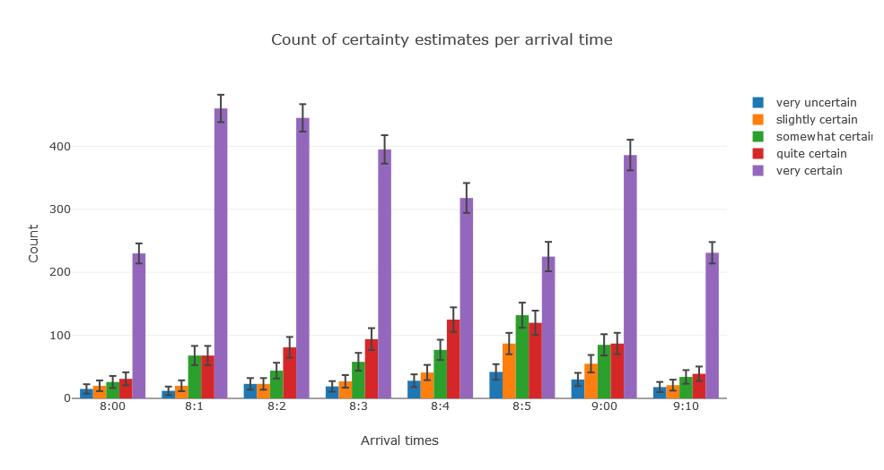
Plot 6

Slide 8
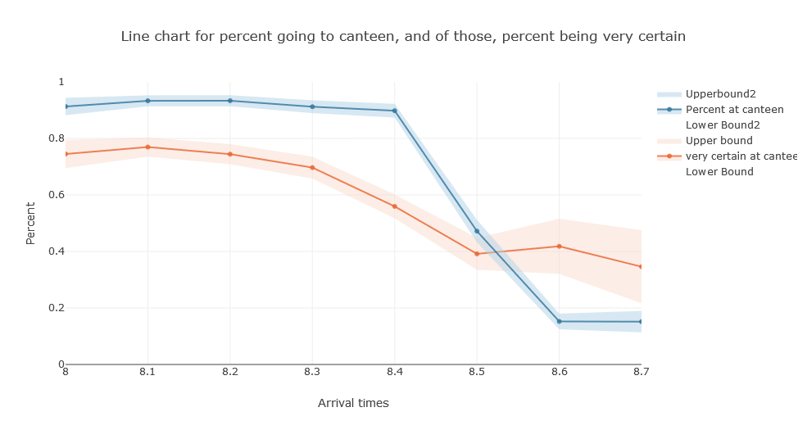
Plot 7

Slide 9
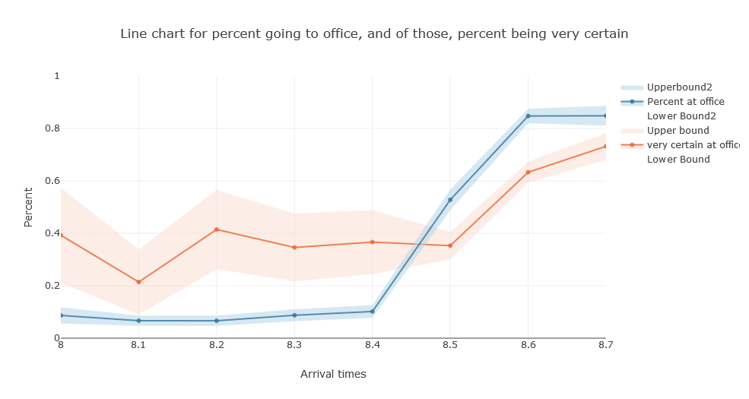
Plot 8

Slide 10
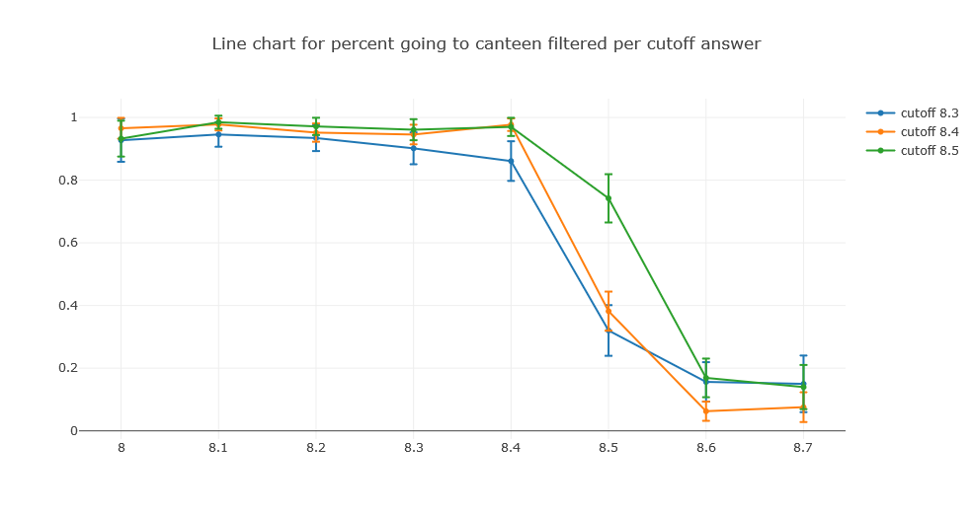
Plot 9

Slide 11
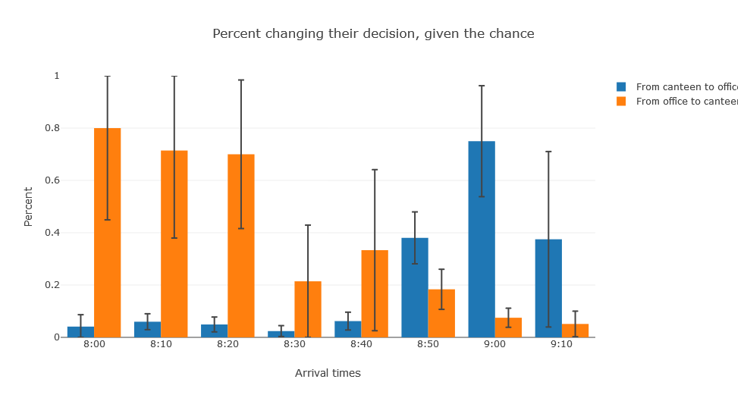
Plot 10

Slide 12
Problemer med at anvende Theory of Mind selv for voksne (Keysar et al. 2003)
” Our findings show that adults do not reliably consult this crucial knowledge about what others know when they interpret what others mean.” (Keysar et al. 2003)
“Possessing a capacity and actually using it to interpret social action, however, are two different things.” (Keysar et al. 2010)
“In contrast to such situations [of lack of knowledge], our participants had firm knowledge of either the ignorance of the director or her concrete false belief. They knew exactly what she knew and didn’t know and had no difficulty keeping the two apart. So despite the fact that our participants did not reflectively impute their own knowledge onto the director, they behaved as if the director was referring to an object of whose existence she was unaware. In short, they did not reliably deploy their sophisticated theory of mind to interpret the intention of the director.” ´(Keysar et al. 2003)
M.a.o: For at anvende Theory of Mind er det nødvendigt at ikke blot have den kognitive kapacitet (som små børn ikke har), men også at være klar over at det er til ens fordel at gøre det.

Slide 13
Givet at meget information antages at være common knowledge, er det ofte ikke nødvendigt at lave en distinktion mellem andres viden og ens egen. Desuden, grundet mentale omkostninger ved ToM kan det muligvis betale sig at udelade ToM, indtil at fordelen ved ToM viser sig igennem overraskende konsekvenser/handlinger.
“People need not always employ their theory of mind to understand others’ behavior. In general, the more information a person shares with the actor, the less they need to consult their understanding of the actor’s beliefs and instead can egocentrically use their own private mental states” (Keysar et al. 2010)

Slide 14
Vi ignorerer muligvis ToM enten fordi (1) det er irrelevant i tilfælde af common knowledge og (2) når det er relevant kan vi tillade os at lave fejl, og derefter inddrage ToM
”Under these circumstances [i.e. in the real world, perspectives tend to coincide], directly computing what another person knows or does not know at a given moment might be more trouble than it is worth. Furthermore, even when perspectives do not coincide, feedback from one’s partner can obviate the need to compute that person’s perspective for successful coordination. For example, although participants in our experiments often moved hidden objects, the director quickly corrected them and they eventually moved the correct object. Although participants could have pre-computed the director’s perspective, they got away with being egocentric because they could count on the director’s feedback. In short, the dynamic nature of face-to-face interaction gives people latitude to be egocentric by effectively distributing the burden of perspective taking across interlocutors” (Keysar et al. 2003)

Slide 15
ToM er mentalt anstrengende:
“Our findings converge with existing evidence that suggest that the use of theory of mind is effortful.” (Keysar et al. 2010)
“Although it appears that people interpret others’ mental states relatively effortlessly, what people do reflexively is use their own mental states. Using one’s knowledge of another person’s beliefs and mental states requires effortful attention. When attentional capacity is either chronically limited or momentarily constrained, a person is likely to interpret another’s actions by relying on what is on his or her own mind, rather than what is on the others’ mind.” (Keysar et al. 2010)

Slide 16
Curse of Knowledge (Birch & Bloom)
“Our findings demonstrate that an adult’s own knowledge can compromise his or her ability to reason about other people’s false beliefs and to make predictions about their actions. Subjects who knew the specific outcome of the displacement event and had available a plausible explanation for Vicki to act in accord with their knowledge were significantly less likely to predict that Vicki would act according to a false belief than were subjects who did not know the specific outcome.” (Birch & Bloom 2007)
Dvs. det er sværere at modellere andre som uvidende om P, hvis man selv ved P. Sådan videns-bias er tilsyneladende stærkere jo mere retfærdiggjort man er i at vide P.

Slide 17
Parametre for mulig variation i ræsoningsevne (Liu 2008)
(a) inferential/computational power: making all possible proof steps,
(b) introspection: being able to view yourself in “meta-mode”.
(c) observation: variety of agents’ powers for observing current events,
(d) memory: agents may have different memory capacities, e.g., storing only the last k events observed, for some fixed k.
(e) revision policies: varying from conservative to radical revision.
Muligvis ‘observationskraft’ som har været største begrænsning ift. turkers valg.

Slide 18
Problemer og forbedringer
Der er 98 (ca 15%) ved 9:00 og 52 (ca 15%) ved 9:10 der har valgt Kantine, dvs. En 0-ordens ToM fejl.
Mulige årsager (1) et ‘narrativ’ om man hellere vil i kantinen end på kontoret, og (2) tilfældige valg, eller menneskelig fejl. Se dog (Wason 1971) for evidens for at “thematic” forbedrer ræsineringsevne over abstrakt fremstilling af problemer
Andre mulige årsager er givet forsøgsopstilling:
“Both of you like to meet in the canteen for a coffee. If you arrive before 9:00 am, you have time to go to the canteen, but you should only go if your colleague goes to the canteen as well. If you or your colleague arrive at 9:00 am or after, you should go straight to your offices.”
Første sætning kan muligvis være blevet fortolket som at ens præferencer I spillet er at altid mødes I kantinen (man ignorerer resten, og tror altid man kan gå I kantinen). Anden sætning kan være blevet fortolket som (du kan gå I kantinen før 8:50 og du skal ikke gå I kantinen hvis din partner ikke går I kantinen). Det er muligt at den anden konjunkt er blevet ignoreret.
Grundet en fejl/teknisk problem havde deltagere 90 sekunder til at læse Instructions og 61 sekunder ved hver runde hvor instructions også stod, I stedet for de intenderede 180 sekunder til første læsning af Instructions.

Slide 19
Læring/fremtidig forbedring
Specifikt for AMT eksperimenter:
Under pilot-tests kan man evt. spørge deltagere om feedback i form af metaspørgsmål, evt.
Hvor godt passede tidsbegrænsingen, havde du for meget / for lidt tid til diverse elementer?
Hvor godt forstod du reglerne, kan du genfortælle dem her?
Generel feedback, andre kommentarer
Generelt ift. eksperimenter om ‘eliciting belief’:
Gør det klart hvilken logisk mening man gerne vil udtrykke i de instrukser og spørgsmål man stiller, og derefter ret spørgsmål ind i normalsproget så de udtrykker den logiske mening så utvetydigt som muligt.
Gør det klart hvilke parametre som kan spille ind: Task dependence, curse of knowledge, spontaneous vs reflective use, abstract / thematic narrative

Slide 20
Literatur indenfor logik og kognition
Studying strategies and types of players: experiments, logics and cognitive models (Verbrugge, Ghosh 2017)
Diversity of Logical Agents in Games (Liu 2008)
Cognition as interaction (Benthem 2007)

